Slide 1

Property Tax Oversight Update
Florida Tax Collectors Association
April 23, 2012
Presented by
Howard Moyes
Florida Department of Revenue

Slide 2
Did You Know?
Tax Theory vs. Tax Practice
  Tax theory is when you think you know something but it doesn’t work.
  Tax practice is when something works but you don’t know why.
  Typically, governments combine theory and practice so that nothing works and no one knows why.
      -- Billy Hamilton, Former Texas Deputy Comptroller

Slide 3
Presentation Summary
Statewide Data
Partial Payments
Interest Rate on Deferred Payment Tax Certificates
Rules and Forms
Upcoming Training
Budget Review Process
Q&A

Slide 4
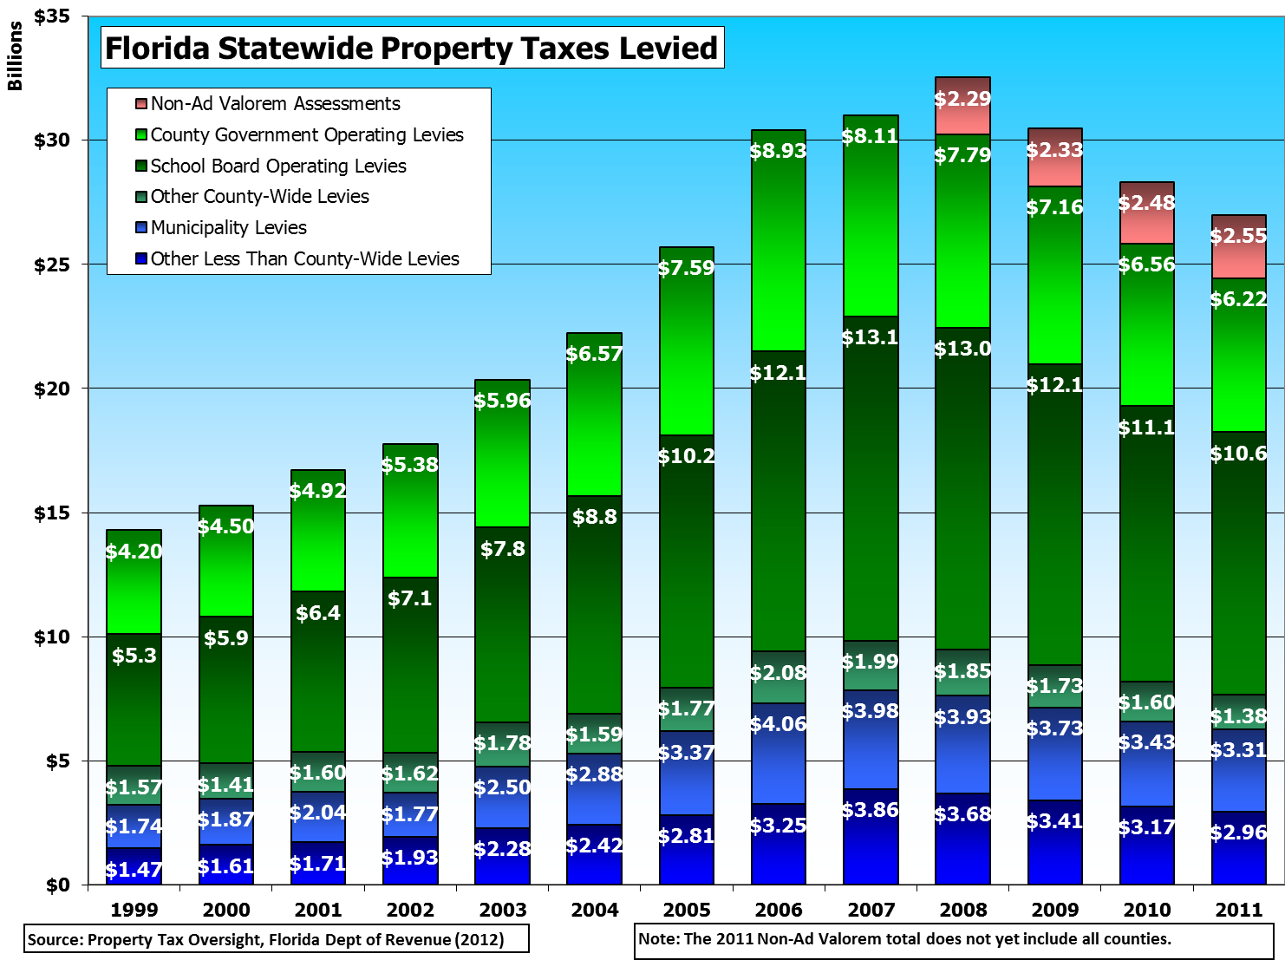
Statewide Data

Slide 5
Non-Ad Valorem Data

Slide 6
Partial Payments
Section 194.014, F.S.
  Requires taxpayers with a pending VAB petition to make a partial payment of property taxes before April 1
    Pending petition is any petition that has not received final approval or denial by the Board
  New Form DR-485D, Decision of VAB – Denial for Non-Payment
  Rules are currently under development

Slide 7
Deferred Payment Tax Certificate Interest Rate
Interest Rate for 2012 is 4.80%
  Refer to PTO Bulletin 12-01
  Issued on April 12, 2012
  Contact Andrew Collins with Questions
    850-617-8554
    Collinan@dor.state.fl.us

Slide 8
Rule Chapter 12D-13, F.A.C.
Proposed Timeline
  April – May: Revisions to 1st draft
  June 15: Discussion with Tax Collectors
  July: Review by DOR General Counsel
  August: Draft posted for public comment
  October/November: Public Workshop
  ??? Adoption by Governor & Cabinet

Slide 9
Revised Forms
DR-462 – Refund Application
DR-528 – Tax Bill Template
DR-534 – Alternative Payment Notice
DR-570 – Homestead Deferral
DR-570AH – Affordable Housing Deferral
DR-570WF – Waterfront Deferral
DR-571A – Denial of Tax Deferral

Slide 10
Forms Under Development
DR-453 – Notice of Tax Lien, HOX
DR-505 – Errors, Insolvencies & Doubles
DR-509 – Tax Certificate
DR-512 – Application for Tax Deed
DR-513 – Certification of Tax Deed App.
DR-514 – Notice of TPP Sale, Delinquent
DR-518 – Cutout Request
DR-517 – Tax Collector’s Warrant
DR-517L – Warrant Leasehold Taxes

Slide 11
Forms Being Repealed
DR- 507C – List of Sold Certificates
DR-517C – Warrant Register

Slide 12
Upcoming Training
TCC 502, Management of a Florida Tax Collector’s Office
  June 25-29, Lake Mary
TCC 504, Collection of Licenses, Taxes and Fees
  August 20-24, Tallahassee
TCC 503, Collection and Distribution of Property Taxes & Special Assessments
  Conversion to online training underway

Slide 13
Budget Review Process
No change in process for 2012
Section 195.087, F.S., requires DOR to monitor expenditures of any tax collector who is leaving office
  Can’t spend more than 1/12th of budget each month
Post-election Choice of Budget Review
  BOCC or DOR
    If DOR, Tax Collector needs to submit a resolution from BOCC
    Reminder letter will be sent in the summer

Slide 14
Questions?

